Slide 1

Activities and Discussions CSG2344
Project Methods and Professionalism
Project Risk
For discussion and thought
ECU Copyright 2014 – CSG 2344 School of Computer and Security Science

Slide 2

Activity objectives
Who has been bungy-jumping?
Who would like to go bungy-jumping?
Who definitely never wants to go bungy-jumping?
What about sky-diving?
……...scuba-diving?
…rock climbing?
What about bush-walking?
ECU Copyright 2014 – CSG 2344 School of Computer and Security Science

Slide 3
What activities are worth the risk?
What reasons were there for your answers?
Were the reasons different for the different activities?
Why?
Can you quantify your reasons?
What if you were offered $5 to do the activity you least want to? Would you do it?
What if you were offered $150?
…. $500,000?
ECU Copyright 2014 – CSG 2344 School of Computer and Security Science
Notes:
like biological life cycle
start as a gleam in someones eye…
birth
development
useful life
loss of fitness for purpose ---surgery
death

Slide 4

Threat and Risk?
What is a threat?
What is a risk?
ECU Copyright 2014 – CSG 2344 School of Computer and Security Science
Notes:
like biological life cycle
start as a gleam in someones eye…
birth
development
useful life
loss of fitness for purpose ---surgery
death

Slide 5

It depends on…?
What different types of risk might affect a project?
Which knowledge areas would they affect?
ECU Copyright 2014 – CSG 2344 School of Computer and Security Science

Slide 6
What is your risk appetite?
Does everyone perceive risk in the same way?
Examples?
ECU Copyright 2014 – CSG 2344 School of Computer and Security Science

Slide 7
What is your risk appetite?
How would you go about identifying project risks?
ECU Copyright 2014 – CSG 2344 School of Computer and Security Science

Slide 8
What is your risk appetite?
How do you decide which risks you need to address and when?
ECU Copyright 2014 – CSG 2344 School of Computer and Security Science

Slide 9
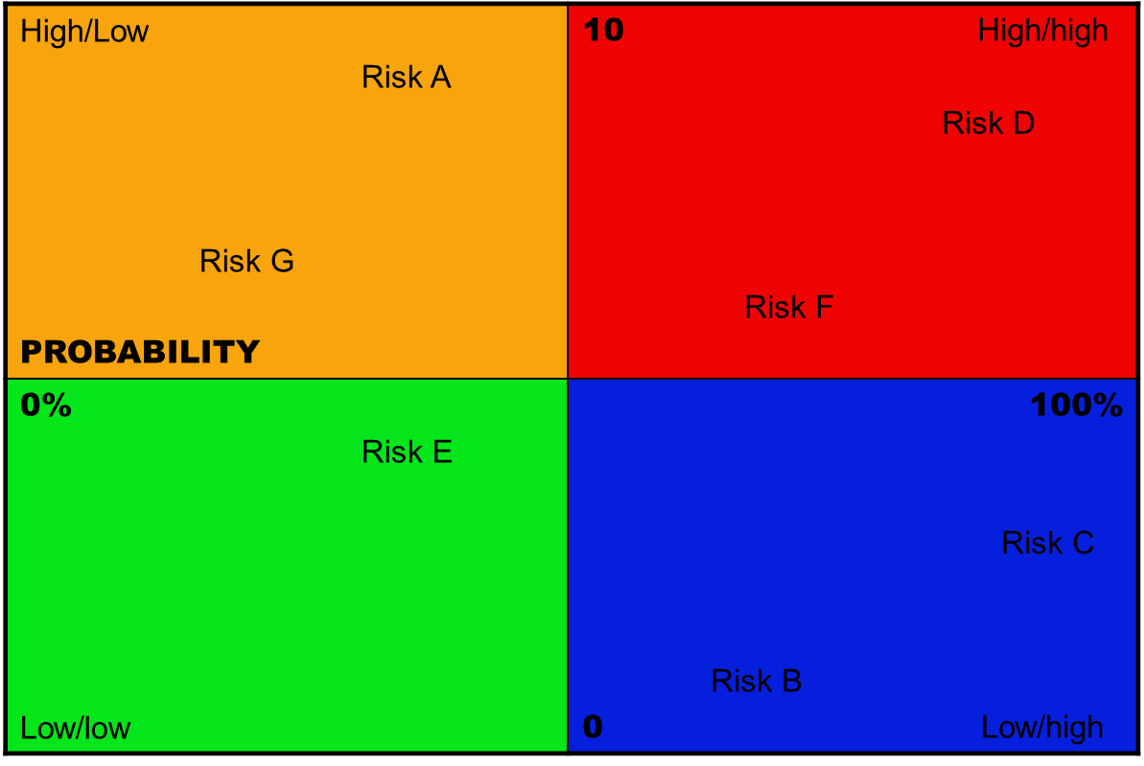
What is your risk appetite?
Risk Grid – Probability and Impact
ECU Copyright 2014 – CSG 2344 School of Computer and Security Science

Slide 10
Risk Priorities
Now you have prioritised
the risks…
what should you do next?
ECU Copyright 2014 – CSG 2344 School of Computer and Security Science

Slide 11
Risk Treatments
What are the different response strategies that you should consider?
Avoidance, Acceptance, Transference, Mitigation,
ECU Copyright 2014 – CSG 2344 School of Computer and Security Science

Slide 12
Monitoring and Control
Once you have treated the risks what else should you do?
( how do you check to see if new risks emerge?)
ECU Copyright 2014 – CSG 2344 School of Computer and Security Science

Slide 13
The Risk Management PLan
Identify the areas at risk (staff, budget,etc)
Identify and assess the risks
Prioritise
Allocate responsibility
Treat
Monitor and control
Document everything.
ECU Copyright 2014 – CSG 2344 School of Computer and Security Science

